Slide 1
Hypothesis
Hypothesis:
We hypothesize that risk perception is higher in professionals that have exposure of previous injuries/fatalities.
Also that professionals in educational and Health care institutions have a lower risk perception than those in Manufacturing. In last committee meeting they asked me to expand the population, not limited to educational and health care institutions. So, I am expanding it to Adminstratrative (white collar) type of occupations and Non-Administrative type of occupations (more field like type of jobs).
Relative Fatality Index
Risk perception
Risk
Figure 1: Graphical Representation of Hypothesis.

Slide 2
DATA OVERVIEW

Slide 3
Data Overview:
For our proposed risk analysis, we will be obtaining fatality and workplace injury data from the department of US labor statistics. These variables are GENDER, AGE, LENGTHOFSERVICE, RACE, and SOCJOBCODE.
The SOCJOBCODE is a numerical valued categorical classification system, that is used to encode the occupational type, however it is encoded in such a way, that it can also be used as an independent variable. The SOC job code number is a six digit number, where the powers of 10 place value, implement a value of manual operation encoding. The numerical range of this encoding is also enumerated in increasing risk order, since the employment classifications at the lower range of value represents an occupation with a higher degree of administrative type work.
Administrative
11-XXXX Management Occupations
13-XXXX Business and Financial Operations Occupations
15-XXXX Computer and Mathematical Occupations
17-XXXX Architecture and Engineering Occupations
19-XXXX Life, Physical, and Social Science Occupations
21-XXXX Community and Social Service Occupations
23-XXXX Legal Occupations
25-XXXX Educational Instruction and Library Occupations
27-XXXX Arts, Design, Entertainment, Sports, and Media Occupations
29-XXXX Healthcare Practitioners and Technical Occupations
31-XXXX Healthcare Support Occupations
33-XXXX Protective Service Occupations
35-XXXX Food Preparation and Serving Related Occupations
37-XXXX Building and Grounds Cleaning and Maintenance Occupations
39-XXXX Personal Care and Service Occupations
41-XXXX Sales and Related Occupations
43-XXXX Office and Administrative Support Occupations
45-XXXX Farming, Fishing, and Forestry Occupations
47-XXXX Construction and Extraction Occupations
49-XXXX Installation, Maintenance, and Repair Occupations
51-XXXX Production Occupations
53-XXXX Transportation and Material Moving Occupations
55-XXXX Military Specific Occupations
Non-Administrative

Slide 4
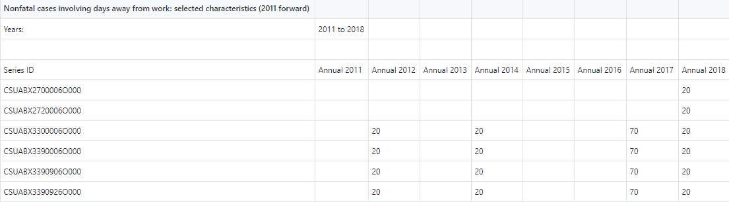
Data Methodology: (file structure)
All the data was collected from the US department of Labor , and uploaded to a GITHUB repository. A series of Jupyter python programs was created to parse the data for analysis. The data is stored as individual files for each independent variable:
In each file you will find eight sample values for each SOC job category, as shown below:
Independent Variables → | Age | Gender | Length of Service | Race
Type of Variable → | Categorical Continuous | Categorical | Categorical Continuous | Categorical
 | NF_AGE_14to15_all.xlsx NF_AGE_16to19_all.xlsx NF_AGE_20to24_all.xlsx NF_AGE_25to34_all.xlsx NF_AGE_35to44_all.xlsx NF_AGE_45to54_all.xlsx NF_AGE_55to64_all.xlsx NF_AGE_65plus_all.xlsx NF_AGE_NR_all.xlsx | NF_GENDER_F_all.xlsx NF_GENDER_M_all.xlsx NF_GENDER_NR_all.xlsx | NF_LOS_ltg3mos_all.xlsx NF_LOS_3to11mos_all.xlsx NF_LOS_1to5yr_all.xlsx NF_LOS_5plus_all.xlsx NF_LOS_NR_all.xlsx | NF_RBX_Asian_all.xlsx NF_RDX_Hispanic_all.xlsx NF_REX_Hawaiian_all.xlsx NF_RFX_White_all.xlsx NF_RGX_NR_all.xlsx NF_RHX_Multi_all.xlsx NF_RIX_Hispanic_all.xlsx NF_RCX_Black_AfricanAmerican_all.xlsx NF_RAX_AmericanIndian_AlaskaNative_all.xlsx

Slide 5
Occupation Type: SOC Standard Occupational Classification
Each SOC job category number is used to encode a branch of occupation. The SOC job code consists of 6 numbers, that when read from left to right will further subdivide the group into more specifications. The job code is used to denote a location in a TREE of occupations.
11-0000 Management Occupations
11-1000 Top Executives
11-1010 Chief Executives
11-1011 Chief Executives
11-1020 General and Operations Managers
11-1021 General and Operations Managers
11-1030 Legislators
11-1031 Legislators
11-2000 Advertising, Marketing, Promotions, Public Relations,
and Sales Managers
11-2010 Advertising and Promotions Managers
11-2011 Advertising and Promotions Managers
11-2020 Marketing and Sales Managers
11-2021 Marketing Managers
11-2022 Sales Managers
11-2030 Public Relations Managers
11-2031 Public Relations Managers
11-3000 Operations Specialties Managers
11-3010 Administrative Services Managers
11-3011 Administrative Services Managers
11-3020 Computer and Information Systems Managers
.
.
.
.
.
11-9140 Property, Real Estate, and Community AssociationManagers
11-9141 Property, Real Estate, and Community Association Managers
11-9150 Social and Community Service Managers
11-9151 Social and Community Service Managers
11-9190 Miscellaneous Managers
11-9199 Managers, All Other
13-0000 Business and Financial Operations
13-1000 Business Operations Specialists
13-1010 Agents and Business Managers of Artists, Performers, and Athletes
13-1011 Agents and Business Managers of Artists, Performers, and Athletes
13-1020 Buyers and Purchasing Agents
13-1021 Purchasing Agents and Buyers, Farm Products
13-1022 Wholesale and Retail Buyers, Except Farm Products
13-1023 Purchasing Agents, Except Wholesale, Retail, and Farm Products
13-1030 Claims Adjusters, Appraisers, Examiners, and Investigators
13-1031 Claims Adjusters, Examiners, and Investigators
13-1032 Insurance Appraisers, Auto Damage
13-1040 Compliance Officers, Except Agriculture, Construction, Health and Safety, and Transportation
13-1041 Compliance Officers, Except Agriculture, Construction, Health and Safety, and Transportation
13-1050 Cost Estimators
13-1051 Cost Estimators
13-1060 Emergency Management Specialists
13-1061 Emergency Management Specialists
13-1070 Human Resources, Training, and Labor Relations
.
.
(https://github.com/ehsintegration/yfd-phd-bls-data/blob/master/DATA/SOC_all.xlsx)
The following file contains the standard occupational coding that is used to index the data.

Slide 6
Data Analysis: SOC (continued)
Here is an example of the TREE encoding system, with further descendant selectivity. The “X”s below can be viewed as a don’t care.
The occupational code is a 6 different number that clusters occupations into finer and finder resolutions.
Therefore a occupational index of “23XXXX” will select all “legal occupations”
And a occupational index of “231XXX” will select all “lawyers, judges, and related workers”
And a occupational index of “231011” will select all “lawyers”
Administrative
11-XXXX Management Occupations
13-XXXX Business and Financial Operations Occupations
15-XXXX Computer and Mathematical Occupations
17-XXXX Architecture and Engineering Occupations
19-XXXX Life, Physical, and Social Science Occupations
21-XXXX Community and Social Service Occupations
23-XXXX Legal Occupations
25-XXXX Educational Instruction and Library Occupations
27-XXXX Arts, Design, Entertainment, Sports, and Media Occupations
29-XXXX Healthcare Practitioners and Technical Occupations
31-XXXX Healthcare Support Occupations
33-XXXX Protective Service Occupations
35-XXXX Food Preparation and Serving Related Occupations
37-XXXX Building and Grounds Cleaning and Maintenance Occupations
39-XXXX Personal Care and Service Occupations
41-XXXX Sales and Related Occupations
43-XXXX Office and Administrative Support Occupations
45-XXXX Farming, Fishing, and Forestry Occupations
47-XXXX Construction and Extraction Occupations
49-XXXX Installation, Maintenance, and Repair Occupations
51-XXXX Production Occupations
53-XXXX Transportation and Material Moving Occupations
55-XXXX Military Specific Occupations
We can also see that the numbering system increases in a numerical order, in proportionality to human physical manual difficulty.
Non-Administrative

Slide 7
MATHEMATICAL OVERVIEW

Slide 8
Mathematical Summary:
Now that we are familiar with the data files and their contents, we can further explore the type of data collected and the reasoning behind it.
We have one dataset for all FATAL counts for each SOC job code.
We also have multiple datasets for different INJURY lost work dates, where the counts are organized by AGE, GENDER, RACE, LENGTH OF SERVICE.
In our analysis we are creating a single averaged value for each of the eight years, for each SOC job code. Then we will be taking the log10 of this value and then analyzing the distribution. Therefore, the mathematical process will be:
Fatal risk log factor = -1 * LOG10 [ AVG(FATAL_COUNT / INJURY_COUNT) ]
The logarithmic equation above was used for two reasons:
To factor out the total population size:
(FATAL_COUNT / POPULATION_SIZE) / (INJURY_COUNT / POPULATION_SIZE) = FATAL_COUNT / INJURY_COUNT
To create a factor, where the magnitude of the index will demonstrate fatalities normalized to injuries.
To create a risk perception index.

Slide 9
Mathematical Summary: Risk Perception Defined
Fatal risk log factor (risk perception) = -1 * LOG10 [ AVG(FATAL_COUNT / INJURY_COUNT) ]
The “Fatal risk log factor”, is not only the log of fatalities count divided by injuries count, it is also a measure of risk perception.
In our analysis we will end up with a graph that represents risk perception vs a measure of risk. We will use this graph to analyze the overall response of the data.
Relative Fatality Index
Risk perception
risk perception
Risk
risk
Figure 1: Graphical Representation of Hypothesis.

Slide 10
DATA STORAGE

Slide 11
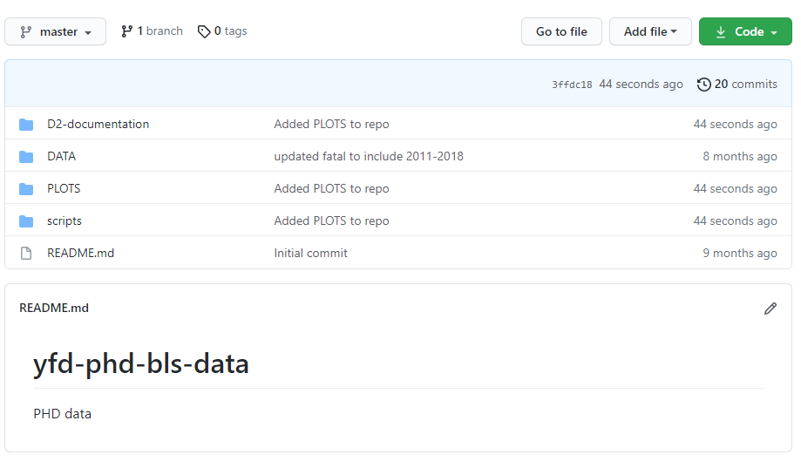
Data Repository Location
https://github.com/ehsintegration/yfd-phd-bls-data
All DATA is kept in the GITHUB depository located in the link above.
The SCRIPTS folder contains the analysis and (RESULTS) for each variable where the graphs are also embed and located within the program itself, or within the PLOTS directory.
DATA
PLOTS
SCRIPTS

Slide 12
Example Data:
The following two slides represent the plots found in the SCRIPTS and PLOTS directories.
More data can be found within the PLOTS directory:
The next slide shows the plot of relative fatal log10 index vs increasing SOC categories level 1. 11XXXX, 12XXXX, 13XXXX…., for the GENDER category.
The slide after that, shows the plot of relative fatal log10 index vs increasing SOC categories level 6. 110000, 111000, 111010…., for the GENDER category.
OBSERVATIONS:
Since, the relative index is a function of, y_{log} = [-1 * log10(y_{data})], then a higher relative log index value correlates to a small fatality/injury rate. Since the categories on the x axis are ranked from left to right with increasing job risk. We can see a positive slope, that indicates that people with a higher perception of risk have a lower fatality rate.
We also believe that we see a relationship of injury count, fatal count, and soc_code combination. Therefore, we should be able to predict a fatality count given an soc_code and injury count.
Any other suggestions as to what other potential statistical measurements we can perform, would be appreciated?
https://github.com/ehsintegration/yfd-phd-bls-data/tree/master/PLOTS

Slide 13
CURRENT RESULTS

Slide 14
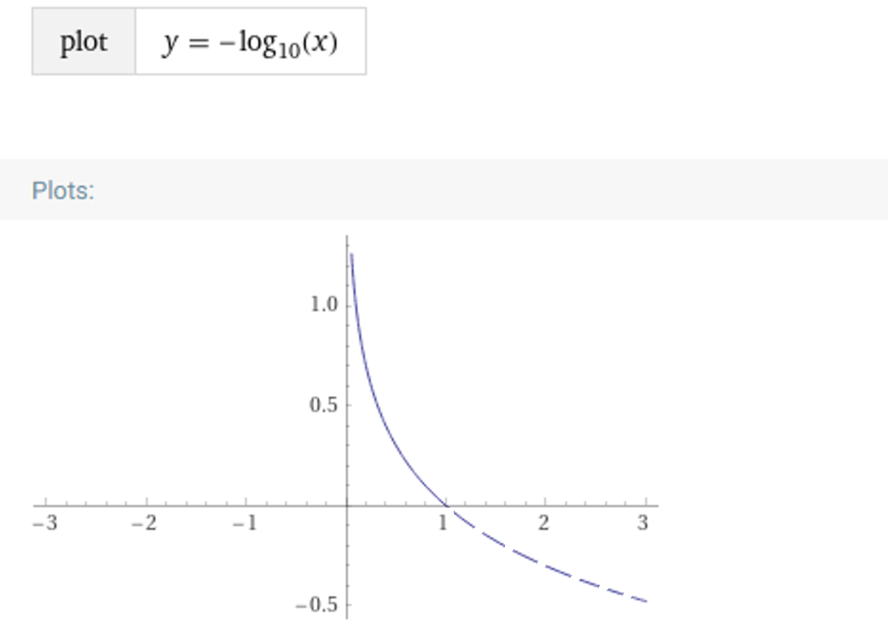
Example Data: Risk Perception Equation
Risk perception index function:
y_{log} = [-1 * log10(y_{data})]
RP_{log} = [-1 * log10(FI_{data})]
The data is being converted to a semi-log plane, so that it forms a linear distribution that can be easily analyzed.
The formula above is how we generate the risk perception index from the fatality/injury rate.
RP
(risk perception index)
F / I
(rate)

Slide 15
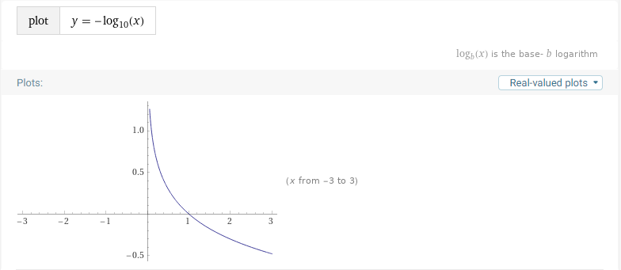
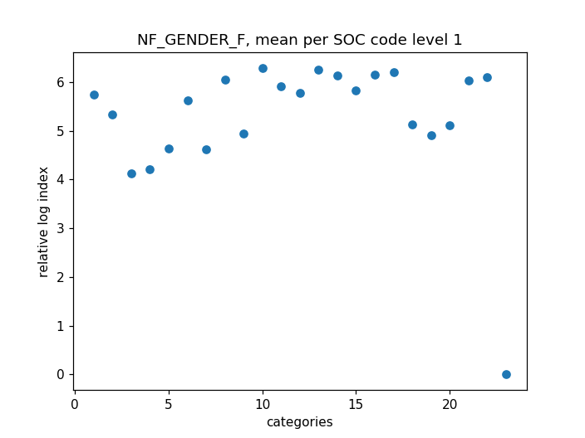
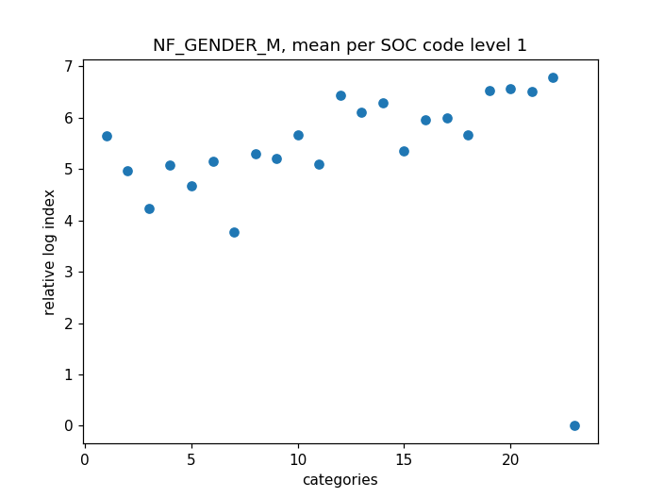
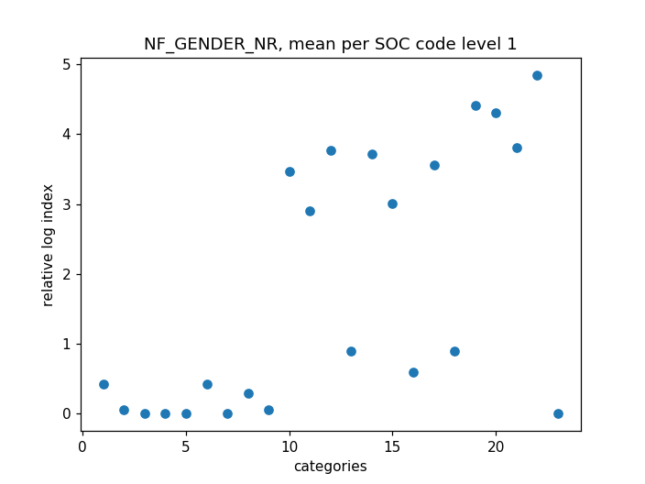
Example Data: SOC level 1 Data for Gender
Since, the relative index is a function of:
RP_{log} = [-1 * log10(FI_{data})],
then a higher relative log index value, correlates to a smaller fatality/injury rate.
Since the categories on the x axis are ranked from left to right with increasing job risk. We can see a positive slope, that indicates that people with a higher perception of risk have a lower fatality rate.
risk perception
risk

Slide 16
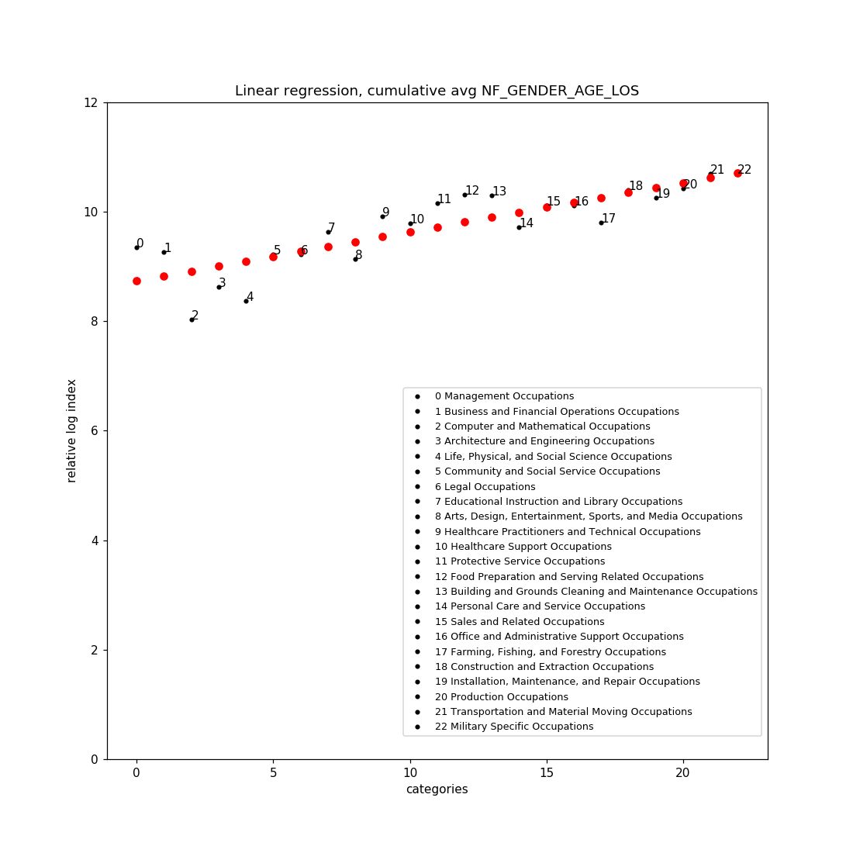
Example Data: Cumulative Averaged Values for GENDER/AGE/LOS, SOC level 1
The graph to the right was created by averaging all the occupational categorical fatality log values. This was done for GENDER, AGE, and LOS (length of service).
RACE also produces a positive slope, however, the correlation of the values to the linear regression, was a better match (better r) when RACE data was not averaged.
risk perception
risk
Notes:
Greater Risk Perception = less fatalities
Fatalities divided by Injuries --→ Risk perception profile
Higher RP, lower fatality rate

Slide 17
Example Data: Conclusion Summary
Since, the relative index is a function of:
y_{log} = [-1 * log10(y_{data})],
then a higher relative log index value, correlates to a smaller fatality/injury rate.
The categories on the x axis are ranked from left to right with increasing job risk. We can see a positive slope, that indicates that people with a higher perception of risk have a lower fatality rate.
The value for index 0 regression, is 8.73 (fatal log index)
The value for index 22 regression is 10.71 (fatal log index)
Since these are log values they are converted with::
True_Fatal/Injury_Rate = 10 ^ (-1 * RP_{logvalue})
Therefore:
The real FI rate for regression index 0 , is 1.841e-09
The real FI rate for regression index 22, is 1.94e-11 (smaller)
This means that the occupation with the most risk for fatality being Military Specific Occupations, actually had the smallest real fatality value (highest perception index). The occupation with the least perceived risk, Management Occupations, had the largest real fatality value (lowest perception index).
Index 22
Index 0
risk perception
risk

Slide 18
Example Data: Conclusion Summary
FI_Rate_{value} = 10 ^ (-1 * RiskPerception_{logvalue})
The occupation with the least perceived risk, Management Occupations, had the largest real fatality value (lowest perception index).
For index 0 regression:
8.73 (lower risk perception index)
1.841e-09 (largest fatality/injury)
The occupation with the most risk for fatality being Military Specific Occupations, had the smallest real fatality value (highest perception index).
For index 22 regression:
10.71 (higher risk perception index)
1.94e-11 (smallest fatality/injury )
Index 22
Index 0
risk perception
risk
Notes:
Why selected the Log Equation used?
Because some data has large values and other small. By taking the log it allows us to look at the data in as a linear distribution.
Then took the anti log in order to convert back to a true (numerical) fatality/injury rate (independent of occupation size).
The X value is risk.

